Slide 1


07
Dominant and Mix Strategy
Samuel Lukas
A Guide to Game Theory by Fiona Carmichael, Prentice Hall, 2005
Introduction Game Theory and Its Applications
Elliott Mendelson, CRC Press Company, Washington DC.2004

Slide 2
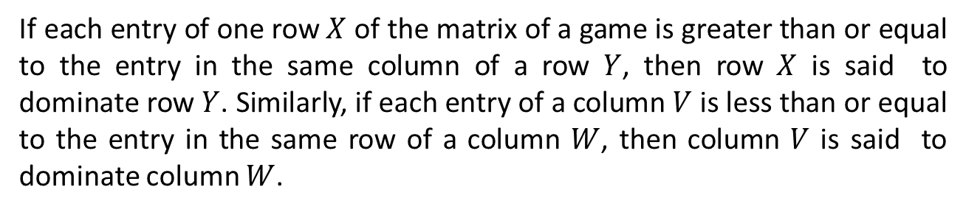
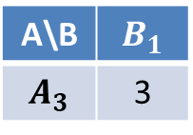
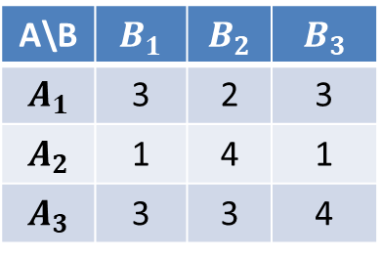
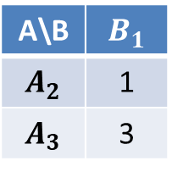
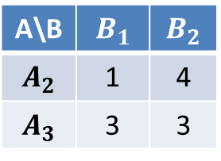
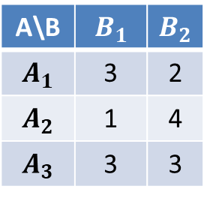
Dominance Strategy
If each entry of one row $X$ of the matrix of a game is greater than or equal to the entry in the same column of a row $Y$, then row $X$ is said to dominate row $Y$. Similarly, if each entry of a column $V$ is less than or equal to the entry in the same row of a column $W$, then column $V$ is said to dominate column $W$.
A\B | $$B_{1}$$ | $$B_{2}$$ | $$B_{3}$$
$$A_{1}$$ | 3 | 2 | 3
$$A_{2}$$ | 1 | 4 | 1
$$A_{3}$$ | 3 | 3 | 4
There is no row dominates other rows however there is column 1 dominates column 3
A\B | $$B_{1}$$ | $$B_{2}$$
$$A_{1}$$ | 3 | 2
$$A_{2}$$ | 1 | 4
$$A_{3}$$ | 3 | 3
Row 3 dominates row 1
A\B | $$B_{1}$$ | $$B_{2}$$
$$A_{2}$$ | 1 | 4
$$A_{3}$$ | 3 | 3
A\B | $$B_{1}$$
$$A_{2}$$ | 1
$$A_{3}$$ | 3
A\B | $$B_{1}$$
$$A_{3}$$ | 3
A will choose strategy 3 and B strategy 1

Slide 3
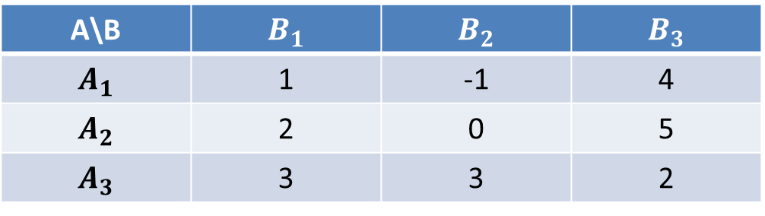




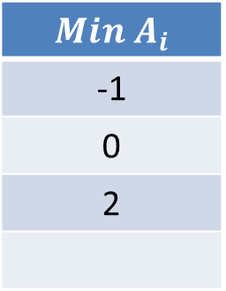
Maximin and Minimax Strategy
For A’s i^{th} strategy, $A_{i},$A will find the minimum entry in the i^{th} row, labeled as $a_{ij}$. It means A can be sure of winning at least that amount. To maximum what A can be sure of winning the game , a should choose the maximum of $a_{ij}$ that what we call as a maxmin strategy. B will choose minmax strategy
Pay-off matrix A and B
A\B | $$B_{1}$$ | $$B_{2}$$ | $$B_{3}$$
$$A_{1}$$ | 1 | -1 | 4
$$A_{2}$$ | 2 | 0 | 5
$$A_{3}$$ | 3 | 3 | 2
$$Min A_{i}$$
-1
0
2
$$\max_{j}$$ | $$3$$ | $$3$$ | $$5$$
${max(min}_{i})=2$
${min(max}_{j})=1,2$
$$(A,B)=\{(3,1),(3,2)\}$$
A will win 2 and B will loose 3

Slide 4
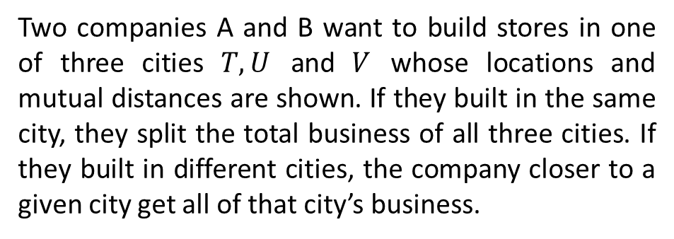
Exercises 02
Find the best strategy of each player
A/B | 1 | 2 | 3 | 4
1 | 3 | 0 | -1 | 0
2 | 1 | 1 | -2 | 1
3 | 0 | 3 | 3 | 1
4 | 2 | 2 | 0 | 1
2.
Two companies A and B want to build stores in one of three cities $T,U$ and $V$ whose locations and mutual distances are shown. If they built in the same city, they split the total business of all three cities. If they built in different cities, the company closer to a given city get all of that city’s business.
T
10
26
U
V
24
All three have the same amount of business. Where they should built the company ?

Slide 5
3.
A \ B | 1 | 2 | 3
1 | 2 , 11 | 8 , 2 | 1, 20
2 | 4 , 9 | 3 , 15 | 9 , 3
3 | 6 , 8 | 5 , 7 | 7 , 6
4. Dua orang politik ingin melakukan orasi politik untuk merekrut sebanyak-banyaknya pendukung dari dua hari masa kampanye yang tersisa di dua kota. Mereka ingin mengambil keputusan untuk memilih strategi terbaiknya dari tiga trategi yang mungkin supaya mendapat hati pemilih sebanyak-banyaknya. Ketiga strategi itu dijabarkan sebagai berikut :

Slide 6
1. Melakukan orasi masing-masing satu hari disetiap kota.
2. Melakukan orasi dua hari penuh di kota satu.
3. Melakukan orasi dua hari penuh di kota kedua.
Untuk kasus ini ada tiga skenario pembuatan matrik keuntungannya. Skenario pertama dinyatakan pada Tabel 3a. Skenario kedua dinyatakan pada Tabel 3b dan skenario ketiga dinyatakan pada Tabel 3c. Apa keputusan dari masing masing skenario ? Jelaskan
Tabel 3a Model Matrik Keuntungan skenario 1
Strategi Politikus Baris | Strategi Politikus Kolom
 | Strategi 1 | Strategi 2 | Strategi 3
Strategi 1 | 1 | 2 | 4
Strategi 2 | 1 | 0 | 5
Strategi 3 | 0 | 1 | -1

Slide 7
Tabel 3b Model Matrik Keuntungan skenario 2
Strategi Politikus Baris | Strategi Politikus Kolom
 | Strategi 1 | Strategi 2 | Strategi 3
Strategi 1 | -3 | -1 | 6
Strategi 2 | 2 | 0 | 2
Strategi 3 | 5 | -1 | -4
Tabel 3c Model Matrik Keuntungan skenario 3
Strategi Politikus Baris | Strategi Politikus Kolom
 | Strategi 1 | Strategi 2 | Strategi 3
Strategi 1 | 0 | -2 | 2
Strategi 2 | 5 | 4 | -3
Strategi 3 | 2 | 3 | -4

Slide 8
Mixed Strategies
Two finger Morra. Each player displays one or two fingers behind his back and at the same time, guesses how many fingers his opponent shows. If both guesses are correct then game is draw. If only one player guesses correctly, that player receives the dollar sum of the fingers shown. Display the pay-off matrix.
A/B | (1,1) | (1,2) | (2,1) | (2,2)
(1,1) | 0 | 2 | -3 | 0
(1,2) | -2 | 0 | 0 | 3
(2,1) | 3 | 0 | 0 | -4
(2,2) | 0 | -3 | 4 | 0
(x,y) means the player shows x and guesses y
So what is the best strategy of A and B ?

Slide 9
Basic Concept
A mixed strategy is essentially a rule that prescribes certain action choices according to a probability distribution.
A \ B | Backdown | Challenge
Backdown | 1 , 1 | 0 , 2
Challenge | 2 , 0 | -3 , -3
A hope that B will choose “backdown” so that A can choose “challenge”. However, It is also what B thinks. But each of them is not clear that it will happen. → What strategy will A or B select ? → Mixed strategy
A expected value of choosing “backdown” is = 0.5 * 1 + 0.5 * 0 = 0.5
A expected value of choosing “challenge” is = 0.5 * 2 + 0.5 *(-3) = -0.5
The best respond of A is “backdown”
The best respond of B is “backdown”
$∴$The best respond of [A,B] is [backdown,backdown]

Slide 10
Example 01
Pay-off for two finger Morra game
X/Y | (1,1) | (1,2) | (2,1) | (2,2)
(1,1) | 0 | 2 | -3 | 0
(1,2) | -2 | 0 | 0 | 3
(2,1) | 3 | 0 | 0 | -4
(2,2) | 0 | -3 | 4 | 0
Assuming the probability Y or X will select each strategy is 0.25 then
$$μ\left(1,1\right)=0.25\left(0+2−3+0\right)=−0.25$$
X will choose strategy 2 or 4
$$μ\left(1,2\right)=0.25\left(−2+0+0+3\right)=0.25$$
$$μ\left(2,1\right)=0.25\left(3+0+0−4\right)=−0.25$$
Y will choose strategy 2 or 4
$$μ\left(2,2\right)=0.25\left(0−3+4+0\right)=0.25$$

Slide 11
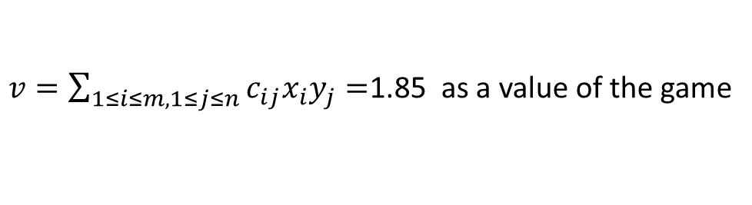
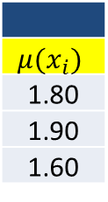

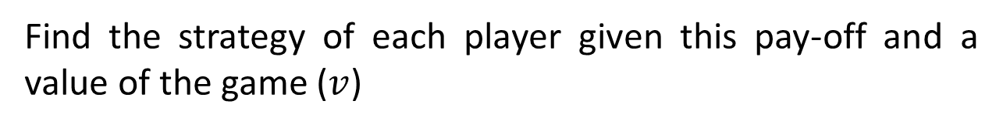


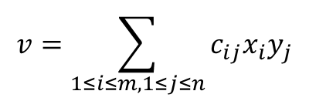
Find the strategy of each player given this pay-off and a value of the game ($v$)
X/Y |  | 1 | 2 | 3
 | Prob | 0.3 | 0.5 | 0.2
1 | 0.5 | 3 | 1 | 2
2 | 0.5 | 4 | 1 | 1
3 | 0 | 2 | 2 | 0
$$μ(x_{i})$$
1.80
1.90
1.60
$$v=\sum_{1≤i≤m,1≤j≤n}{c_{ij}x_{i}y_{j}}$$
$$μ(y_{i})$$ | 3. 50 | 1 | 1.5
Playing maxmin and minmax strategy then
$X$ prefers to choose strategy 1 or 2 and $Y$ chooses strategy 2 or 3
Playing mix strategy then
$$μ\left(x_{1}\right)=0.3∙3+0.5∙1+0.2∙2=1.80$$
$$μ\left(y_{1}\right)=0.5∙3+0.5∙4+0.∙2=3.50$$
$∴$A prefer choose strategy 2 and B prefer choose strategy 2 why ?
$$μ\left(y^{∗}\right)=\min\left\{μ\left(y_{i}\right)\right\}=\min\left\{3.5,1,1.5\right\}=1$$
means of all strategies of $X$
$$μ\left(x^{∗}\right)=\max\left\{μ\left(x_{i}\right)\right\}=\max\left\{1.8,1.9,1.6\right\}=1.9$$
means of all strategies of $Y$
$v=\sum_{1≤i≤m,1≤j≤n}{c_{ij}x_{i}y_{j}=}$1.85 as a value of the game

Slide 12
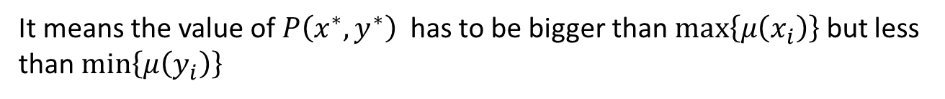



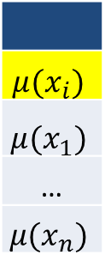
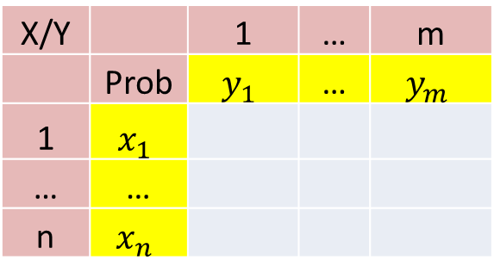
Equilibrium Pair
X/Y |  | 1 | … | m
 | Prob | $$y_{1}$$ | … | $$y_{m}$$
1 | $$x_{1}$$
… | …
n | $$x_{n}$$
$$μ(x_{i})$$
$$μ(x_{1})$$
…
$$μ(x_{n})$$
$$μ(y_{j})$$ | $$μ(y_{1})$$ | … | $$μ(y_{m})$$
Equilibrium pair is stable in the sense that it is unwise for a player to deviate from his mixed strategy in an equilibrium pair if his opponent plays the opponent’s mixed strategy of that pair.
Pair $\left(x^{∗},y^{∗}\right)$ is an equilibrium pair if the following two conditions hold.
$$P\left(x^{∗},y^{∗}\right)≤min⁡\left\{μ\left(y_{j}\right)\right\}$$
&
$$P\left(x^{∗},y^{∗}\right)≥max⁡\left\{μ\left(x_{i}\right)\right\}$$
It means the value of $P\left(x^{∗},y^{∗}\right)$ has to be bigger than $max⁡\left\{μ\left(x_{i}\right)\right\}$ but less than $min⁡\left\{μ\left(y_{i}\right)\right\}$

Slide 13
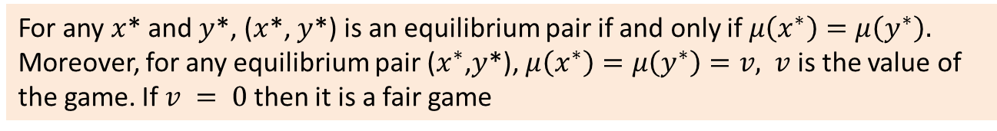

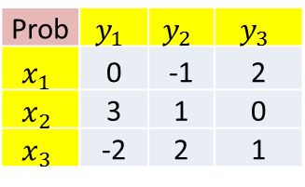







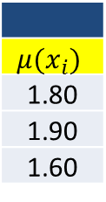
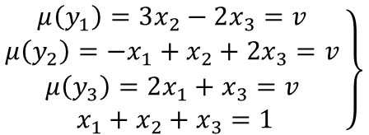
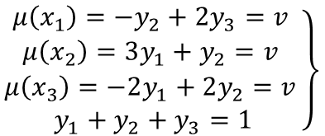
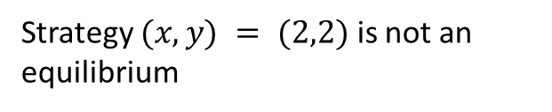
For any $x$* and $y$*, ($x$*, $y$*) is an equilibrium pair if and only if $μ\left(x^{∗}\right)=μ\left(y^{∗}\right).$ Moreover, for any equilibrium pair ($x^{∗}$,$y$*), $μ\left(x^{∗}\right)=μ\left(y^{∗}\right)=v,$ $v$ is the value of the game. If $v = 0$then it is a fair game
Check whether this pay-off has an equilibrium pair or not
X/Y |  | 1 | 2 | 3
 | Prob | 0.3 | 0.5 | 0.2
1 | 0.5 | 3 | 1 | 2
2 | 0.5 | 4 | 1 | 1
3 | 0 | 2 | 2 | 0
$$μ(x_{i})$$
1.80
1.90
1.60
$$μ\left(y^{∗}\right)=\min\left\{μ\left(y_{i}\right)\right\}=1$$
$$μ\left(x^{∗}\right)=\max\left\{μ\left(x_{i}\right)\right\}=1.9$$
Strategy $(x,y) = (2,2)$ is not an equilibrium
$$μ(y_{i})$$ | 3. 50 | 1 | 1.5
Find the value of equilibrium pair of $x$ and $y$
It is also apply to $y$ then
Prob | $$y_{1}$$ | $$y_{2}$$ | $$y_{3}$$
$$x_{1}$$ | 0 | -1 | 2
$$x_{2}$$ | 3 | 1 | 0
$$x_{3}$$ | -2 | 2 | 1
$$\left.\begin{aligned}μ\left(y_{1}\right)=3x_{2}−2x_{3}=v \\ μ\left(y_{2}\right)=−x_{1}+x_{2}+2x_{3}=v \\ μ\left(y_{3}\right)=2x_{1}+x_{3}=v \\ x_{1}+x_{2}+x_{3}=1\end{aligned}\right\}$$
$$\left.\begin{aligned}μ\left(x_{1}\right)=−y_{2}+2y_{3}=v \\ μ\left(x_{2}\right)=3y_{1}+y_{2}=v \\ μ\left(x_{3}\right)=−2y_{1}+2y_{2}=v \\ y_{1}+y_{2}+y_{3}=1\end{aligned}\right\}$$
$∴x_{1}=\frac{6}{24},x_{2}=\frac{11}{24},$ $x_{3}=\frac{7}{24},$ $v=\frac{19}{24}$
$∴y_{1}=\frac{4}{24},y_{2}=\frac{7}{24},$ $y_{3}=\frac{13}{24},$ $v=\frac{19}{24}$
$v ≠0,$The game is not fair

Slide 14


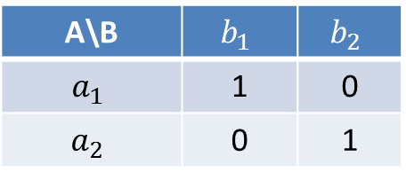
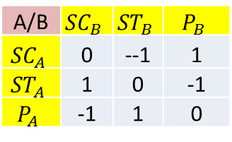
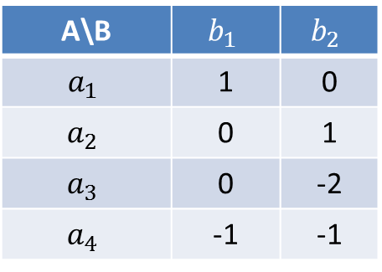



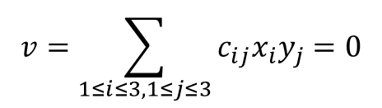
Example 02
Scissors, Stone and Paper Game (Check whether the game is fair or not)
A/B | $${SC}_{B}$$ | $${ST}_{B}$$ | $$P_{B}$$
$${SC}_{A}$$ | 0 | --1 | 1
$${ST}_{A}$$ | 1 | 0 | -1
$$P_{A}$$ | -1 | 1 | 0
$P(A)=\left(\text{1/3,1/3,1/3}\right)$ & $P(B)=\left(\text{1/3,1/3,1/3}\right)$
$$v=\sum_{1≤i≤3,1≤j≤3}{c_{ij}x_{i}y_{j}}=0$$
$∴$The game is fair
A\B | $$b_{1}$$ | $$b_{2}$$
$$a_{1}$$ | 1 | 0
$$a_{2}$$ | 0 | 1
$$a_{3}$$ | 0 | -2
$$a_{4}$$ | -1 | -1
Check whether the game is fair or not
$P(A)=\left(\text{1/}\text{2}\text{,1/}\text{2}\text{,}\text{0,0}\right)$ & $P(B)=\left(\text{1/}\text{2}\text{,1/}\text{2}\right)$
A\B | $$b_{1}$$ | $$b_{2}$$
$$a_{1}$$ | 1 | 0
$$a_{2}$$ | 0 | 1
$$μ\left(a_{1}\right)=μ\left(a_{2}\right)=μ\left(b_{1}\right)= μ\left(b_{2}\right)=1/2$$
$∴ v=$ 1/2
$∴$The game is not fair, player A has an advantage

Slide 15


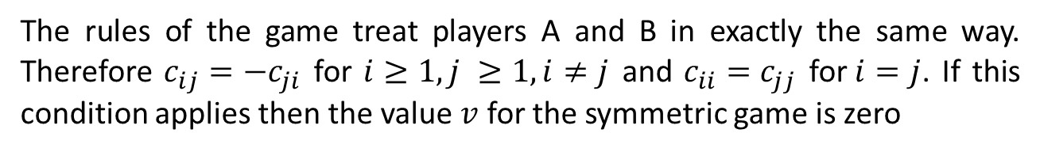

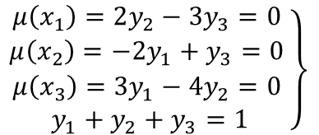
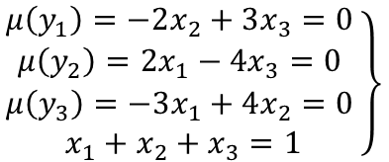
Symmetric Game
The rules of the game treat players A and B in exactly the same way. Therefore $c_{ij}=−c_{ji}$ for $i≥1, j ≥1, i≠j$ and $c_{ii}=c_{jj}$ for$i=j$. If this condition applies then the value $v$ for the symmetric game is zero
Prob | $$y_{1}$$ | $$y_{2}$$ | $$y_{3}$$
$$x_{1}$$ | 0 | 2 | -3
$$x_{2}$$ | -2 | 0 | 4
$$x_{3}$$ | 3 | -4 | 0
$$\left.\begin{aligned}μ\left(x_{1}\right)=2y_{2}−3y_{3}=0 \\ μ\left(x_{2}\right)=−2y_{1}+y_{3}=0 \\ μ\left(x_{3}\right)=3y_{1}−4y_{2}=0 \\ y_{1}+y_{2}+y_{3}=1\end{aligned}\right\}$$
$$\left.\begin{aligned}μ\left(y_{1}\right)=−2x_{2}+3x_{3}=0 \\ μ\left(y_{2}\right)=2x_{1}−4x_{3}=0 \\ μ\left(y_{3}\right)=−3x_{1}+4x_{2}=0 \\ x_{1}+x_{2}+x_{3}=1\end{aligned}\right\}$$
$∴x_{1}=\frac{4}{9},x_{2}=\frac{3}{9},$ $x_{3}=\frac{2}{9},$ $v=0$
$∴y_{1}=\frac{4}{9},y_{2}=\frac{3}{9},$ $y_{3}=\frac{2}{9},$ $v=0$

Slide 16


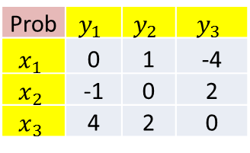

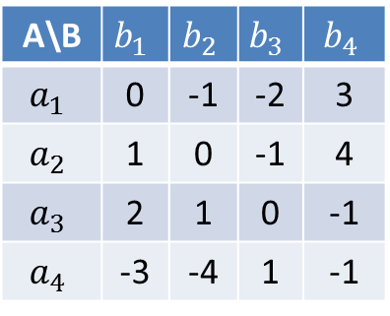

Exercises
Find all the equilibrium pairs for these pay off matrixes and the value of the game
2.
A\B | $$b_{1}$$ | $$b_{2}$$ | $$b_{3}$$ | $$b_{4}$$
$$a_{1}$$ | 0 | -1 | -2 | 3
$$a_{2}$$ | 1 | 0 | -1 | 4
$$a_{3}$$ | 2 | 1 | 0 | -1
$$a_{4}$$ | -3 | -4 | 1 | -1
1.
Prob | $$y_{1}$$ | $$y_{2}$$ | $$y_{3}$$
$$x_{1}$$ | 0 | 1 | -4
$$x_{2}$$ | -1 | 0 | 2
$$x_{3}$$ | 4 | 2 | 0
$∴x_{1}=\frac{2}{7},x_{2}=\frac{4}{7},$ $x_{3}=\frac{1}{7},$ $v=0$
3.
$∴x_{1}=\frac{1}{4},x_{2}=0,$ $x_{3}=\frac{1}{2},x_{4}=\frac{1}{4},v=0$
Prob | $$y_{1}$$ | $$y_{2}$$ | $$y_{3}$$
$$x_{1}$$ | 0 | -1 | 2
$$x_{2}$$ | 3 | 1 | 0
$$x_{3}$$ | -2 | 2 | 1
$∴x_{1}=\frac{6}{24},x_{2}=\frac{11}{24},$ $x_{3}=\frac{7}{24},$ $v=\frac{19}{24}$

